Slide 1
The Gap Inc. E.piphany Relocation Discussion
Introductions, IBM’s Relevant Experience
Solution Overview
IBM Approach (Project Approach, Timeline, Proposal)
Customer ODS Review and Discussion
E.piphany Review and Discussion
Hosting Overview, Infrastructure and Support Review and Discussion
Wrap-Up and Q&A

Slide 2
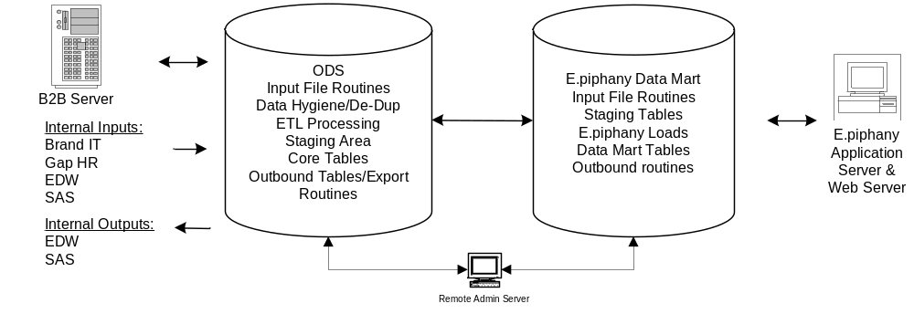
ODS Design Confirmation Process
Our design confirmation will take a process oriented approach to develop a detailed understanding of the technical requirements, identify any areas for improvement, and confirm the project scope
Review Input Staging Data from External and Internal Sources
Review Data Cleansing
Procedures
Review Core Table Staging Process
Review internal
and external
output requirements

Slide 3
Review Input Staging Data from External and Internal Sources
Goals:
Develop an understanding of:
  source file granularity
  frequency of update (delta versus full update)
  relationship of each input file
  aggregation required (if any) within the ODS
Confirm staging table structure for speed input loading and speed ODS loading
Design Metadata input and process
Assumptions:
Current source files must have data sufficient to maintain referential integrity within the ODS; if not, the Gap will need to make a decision on the “go forward” strategy, e.g. address issues with downstream systems or live with implications in the initial implementation.

Slide 4
Review Data Cleansing Procedures (Customer Hygiene and De-duping)
Goals:
Develop a process to:
  Hygiene customer address, customer email, phone number and define gender rules
  Determine the depth of automated rules, manual review and exception reporting
  Encrypt and de-encrypt GE Credit and credit card numbers during hygiene and load
  Determine the depth of automated de-dup rules, manual review and exception reporting for customers
Assumptions:
Gap will share hygiene and de-dup processes currently used and will provide input of comfort levels (x%) and extent of manual processing to be used. Data abnormalities requiring fixes will be corrected in the source systems by the Gap.

Slide 5
Review Core Table Staging Process
Goals:
Develop a process for:
  validating the core data model against business requirements
  mapping all core table data elements to input files
  establishing the table relationship rules to ensure data integrity
  designing the validation scripts required to confirm data integrity
  addressing aggregation as required
Establish Service Level requirements
Assumptions:
All data required for this application are housed in the six input sources provided in the design (B2B, Brand IT, Gap HR, EDW, E.piphany and SAS) and are at the appropriate granularity to ensure data integrity
Unique identifiers are available and can be used for building relationships
History and slowly changing dimensions are available as required by the business
The Gap will provide clear-cut rules for validating data for the application

Slide 6
Review Internal and External Output Process
Goals:
Develop an understanding of:
  file granularity required for output systems, e.g. EDW, SAS, E.piphany, and B2B Server
  frequency of output
  overlap of data moving to output files
Confirm outbound table structure
Design Metadata processes required from ODS to output files
Assumptions:
IBM will “push” files/tables for the four systems as validated during the design confirmation. The Gap will be responsible for “picking up” these files via the four systems.

Slide 7
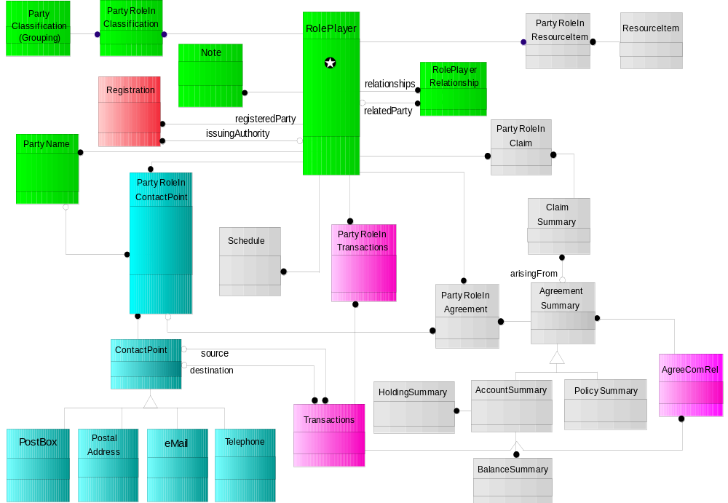
ODS Data Model Review
IBM will leverage existing assets such as the Retail CRMF and CIIS to confirm The Gap current customer data model design
Present “one face” to the customer
Support multiple roles per individual customer
Support different customer definitions including: business, government and consumer
Support definition of roles such as consumer, buyer, sales agent, receiving agent and dimensional categorization
Identify relationships among customers
Classify and track customer interactions (i.e. purchases, ship/receives, direct mail, etc.)

Slide 8
ODS / E.piphany Physical Architecture and Sizing Requirements

Slide 9
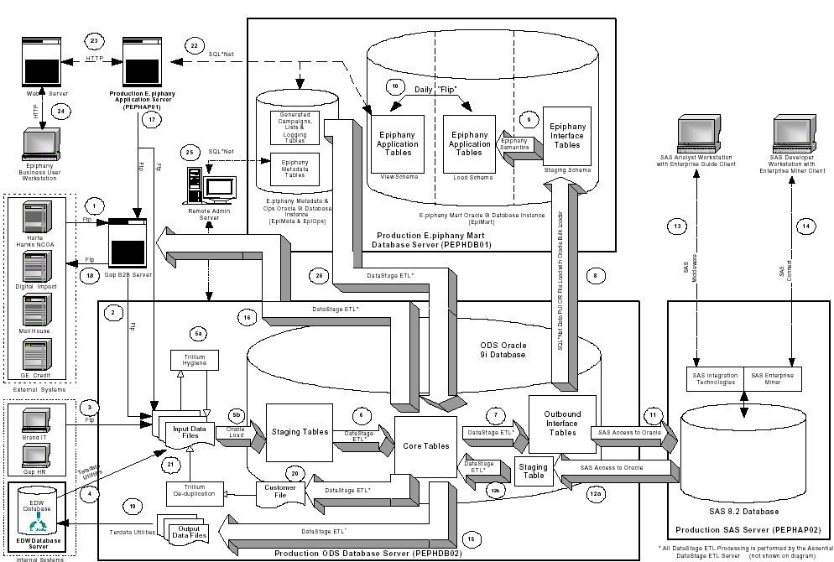
Logical Architecture of the Gap E.piphany Relocation
IBM will follow a structure approach towards reviewing the architecture and data model of the ODS and E.piphany data mart

Slide 10
Proposed Scope for the E.piphany Relocation Project
Proposed Logical Architecture Interface Component | IBM | Gap
1. Inbound External Vendor File Transfer to Gap B2B Server |  | 
2. ODS file pull from B2B Server | 
3. FTP File Transfer of Internal Files | 
4. Teradata Fast Export of Data from EDW | 
5. Hygiene and Load to Staging Tables | 
6. Population of the ODS Core Tables | 
7. Population of the Outbound Interface Tables | 
8. Epiphany Data Pull from Outbound Interface Tables | 
9. Epiphany Semantics (ETL) load | 
10. Epiphany Schema Flip | 
11. SAS Data Pull from Outbound Interface Tables | 
12a. SAS Scoring Update to the ODS - SAS Scoring Push |  | 
12b. SAS Scoring Update to the ODS - SAS Scoring ODS Load | 
13. Analyst SAS Access |  | 

Slide 11
Proposed Scope for the E.piphany Relocation Project
Proposed Logical Architecture Interface Component | IBM | Gap
14. Developer SAS Access |  | 
15. File Extract for Teradata Transaction Filter | 
16. File Extract for NCOA Processing | 
17. Epiphany Campaign Extract | 
18. Gap B2B Server file transfer to Vendor |  | 
19. Teradata Transaction Filter File Transfer | 
20. Customer De-Duplication | 
21. Merged Customer Data Load | 
22. Epiphany Application Server Data Access | 
23. Web Server communication with Epiphany Application Server | 
24. Epiphany Business User access to Epiphany Web Page | 
25. Remote Admin Server | 
26. Epiphany Campaign Definition and Control Group Load into the ODS | 
27. SAS Ad-hoc score update to Epiphany |  | 

